Slide 1

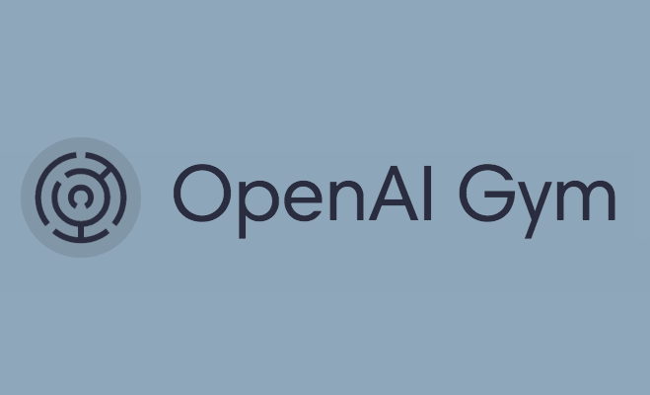
Stock Price Prediction Using REINFORCEMENT Learning
Team Members : Deepak Singh

Slide 2
MOTIVATION
Stock price prediction is a classic problem, with successful model for prediction we can obtain market insights and trends.
With the increased computational power, we can harness reinforcement learning to solve the problem.
Our project is different from any other open-source project as we introduce custom signals to our RL agent.
Link for the GitHub Repo : https://github.com/deepaksinghea/aifinalproj

Slide 3
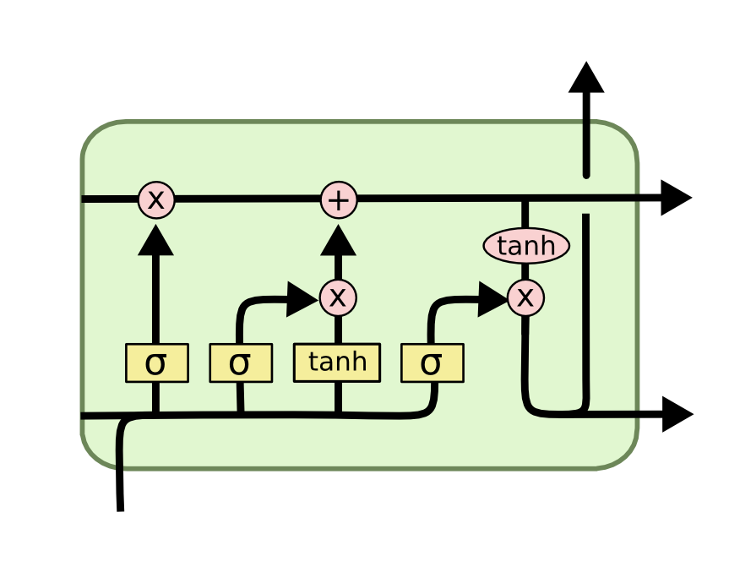
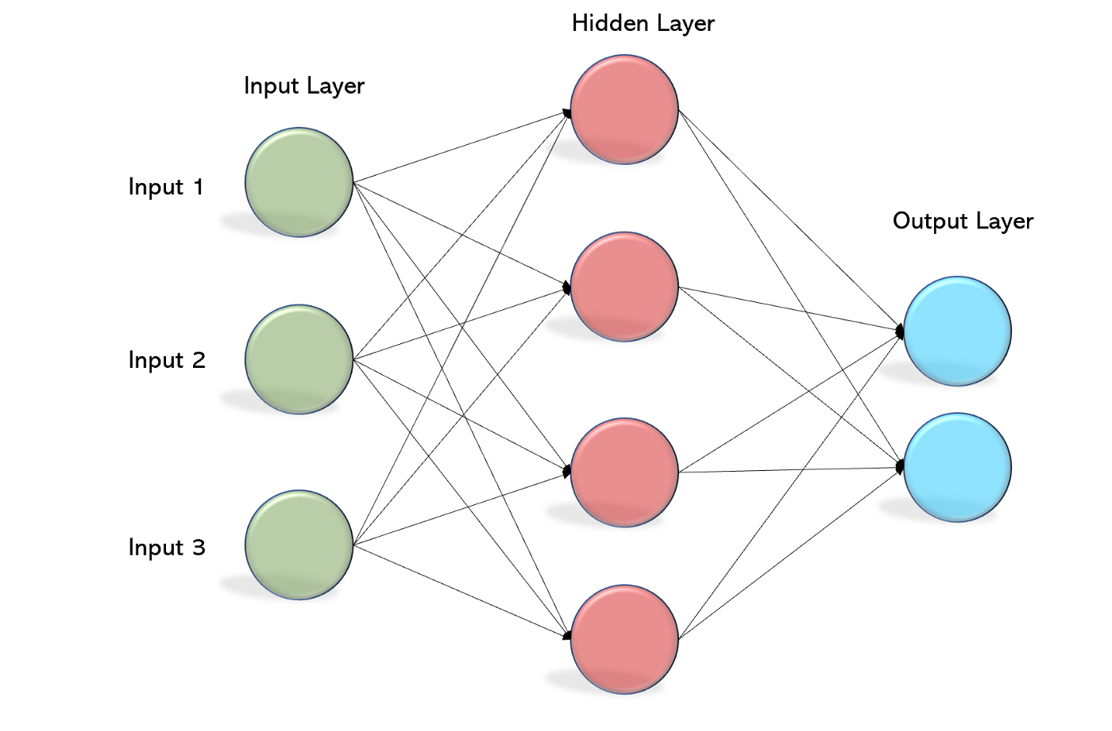
MLP LSTM AGENT
For the implementation, we are using MLP LSTM policy.
This policy uses Long Short Term Memory with Multi-Layer Perceptron feature extraction.
+
LSTM
Multi Layer Perceptron Model

Slide 4
Dependencies for the project
1.TensorFlow
2. Gym
3. Gym Any Trading
Description : Training RL Agent
4. Yahoo Finance API
Description : API for obtaining dataset
5. Fin TA (Financial Technical Analysis)
Description : For Simple Moving Avg, Relative Strength Index, On Balance Volume (Custom Indicators)

Slide 5
methodologies
We are using any-trading with custom signals to improve RL agent performance compared to vanilla RL agent.
We will calculating RSI, OBV and SMA using Fin TA package.
After integrating custom signals, we will re-train and test our new model.
We will perform evaluation on the new model.
We will visualize the result !!

Slide 6
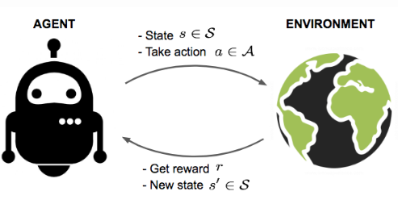
CODING...
Let’s dive into the code : https://github.com/deepaksinghea/aifinalproj/blob/main/Deep_Q_Learning_Stock_Prediction.ipynb

Slide 7
Future scope
We can try different RL agents with varying timestamps to improve our predictions.
We can try to deploy it as a web app using services and packages like AWS, Stream Lit etc.

Slide 8
Thank you !!!

